Slide 1
Kubernetes
Ingress Controllers
Architecture, Design & Testing
Søren Døssing
Platform DevelopMarch 2020ment
March 2020
Netic A/S

Slide 2
Load Balancer
Ingress routing patterns

Slide 3
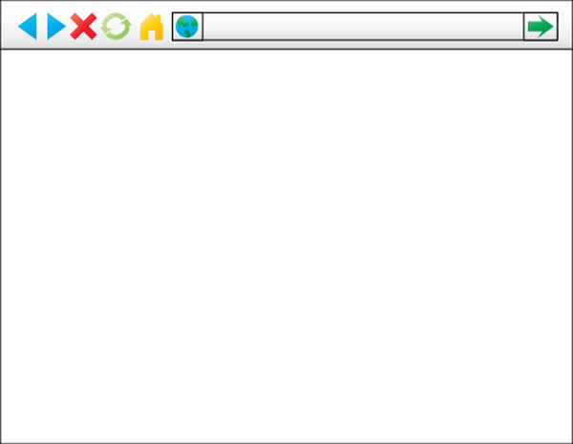

Edge Routing
How to get from web browser to application
Request
web browser
server application

Slide 4





Routing Component Chain
Path from web browser to application
Public IP to private IP
VM IP to container IP
Host header to application
Pod discovery
Container IP
web browser
loadbalancer
kube-proxy
ingresscontroller
service
pod
server application
TLS termination
Where to manage?
telemetry
high availability
etc.

Slide 5
Load Balancer
Ingress routing patterns

Slide 6
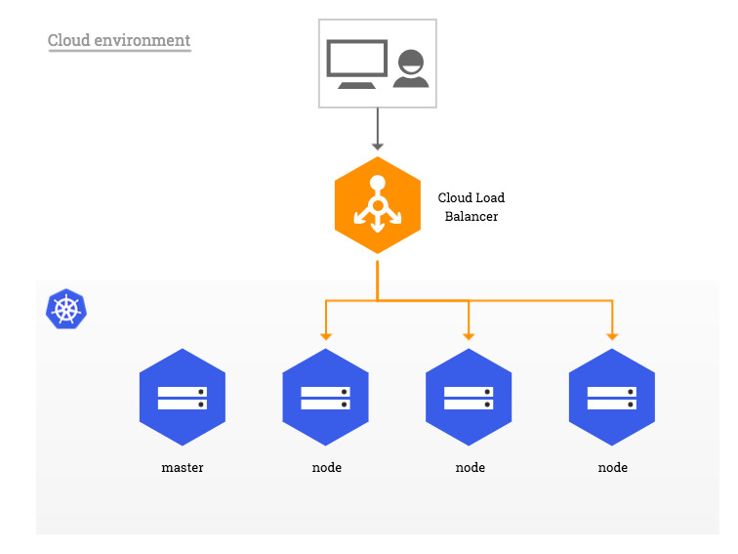
Cloud Loadbalancer
On-demand cloud commodity loadbalancer
Source: https://kubernetes.github.io/ingress-nginx/deploy/baremetal/

Slide 7
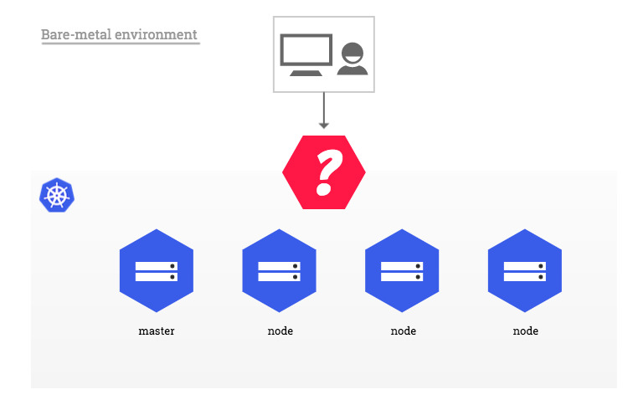
On-premise Loadbalancer
Loadbalancer problem must be solved

Slide 8
Loadbalancer / Ingresscontroller connectivity
Default is to have no connectivity from load balancer to pods
public IP
How to route?
load balancer
node private IP subnet
ingress controller
pod subnet
application pod
Kubernetes cluster

Slide 9
Deployment / nodePort
Exposing a deployment pod using node port
public IP
Which node IP and nodeport?
load balancer
Excessive bouncing?
node
private IP
subnet
nodeport
nodeport
nodeport
deployment
ingress controller
pod subnet
application pod
Kubernetes cluster

Slide 10
Daemonset / hostPort
Exposing pods on all nodes
public IP
How to manage new node IP's in loadbalancer?
load balancer
node
private IP
subnet
hostport
hostport
hostport
future expansion
hostport
daemonset
ingress controller
ingress controller
ingress controller
ingress controller
pod subnet
application pod
Kubernetes cluster

Slide 11
Statefulset / Nodeport
Using particular nodes for ingress
public IP
load balancer
node
private IP
subnet
pet
pet
cattle
How to manage pet nodes and cattle nodes?
nodeport
nodeport
Statefulset
ingress controller
ingress controller
pod subnet
application pod
Kubernetes cluster

Slide 12
External pod network
Managing pod network ourside of Kubernetes cluster
How to manage external pod network?
public IP
load balancer
pod subnet
ingress controller
application pod
Kubernetes cluster
node private IP subnet

Slide 13
Internal load balancer
Running loadbalancer inside Kubernetes cluster
Is is safe to have public IP inside cluster?
public virtual IP
nodeport
load balancer
pod subnet
Kubernetes cluster
ingress controller
application pod
node private IP subnet

Slide 14
Internal load balancer
Using reverse NAT to isolate cluster from Internet
public IP
How to manage node IP and virtual IP on same subnet?
reverse NAT
virtual IP
node
private IP
subnet
nodeport
load balancer
pod subnet
Kubernetes cluster
ingress controller
application pod

Slide 15
Evaluation Environment
Architecture for testing

Slide 16




Testing Environment
Main technologies
Instant Ubuntu VMs. A mini-cloud on your Mac or Windows workstation.
Lightweight Kubernetes.
The certified Kubernetes distribution built for IoT & Edge computing.
CLI and validation tools for Kubelet Container Runtime Interface (CRI)
Using a host port for each service load balancer and setting up iptables to forward the request to the cluster IP.
Hypervisor from Moby project based on xhyve/bhyve optimized for lightweight virtual machines and container deployment. A core component of Docker Desktop For Mac.

Slide 17
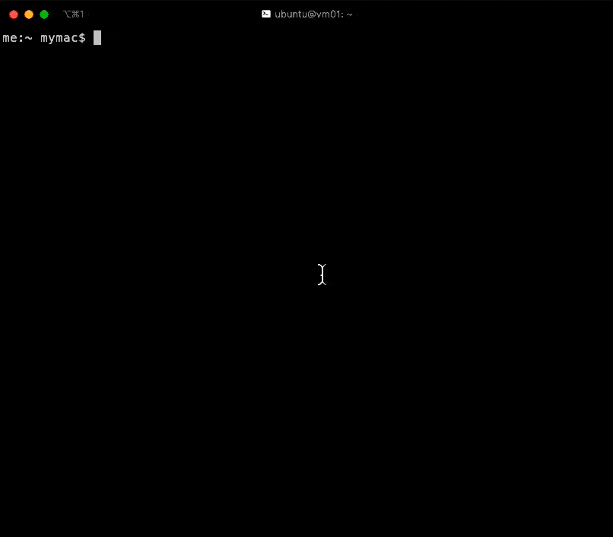


Testing Environment
Bring up Rancher k3s in Canonical Multipass on OSX
multipass
kubectl
bridge100
hyperkit
Ubuntu vm
k3d
cri-tools
klipper-lb
k3s
containerd
systemd-resolver

Slide 18





Contenders
Five ingress controllers
Cloud native edge router
CRD ingress routing and traffic service middleware
Ingress controller for Kubernetes using NGINX as a reverse proxy and load balancer.
A feature-rich, Kubernetes-native ingress controller, and next-generation API gateway.
Kubernetes ingress controller based on HAProxy loadbalancer.

Slide 19





Evaluation Method
Comparison of key default behaviors
Load balancer integration
Metrics
TLS termination
Canary deployment strategy
Dashboard
Performance

Slide 20
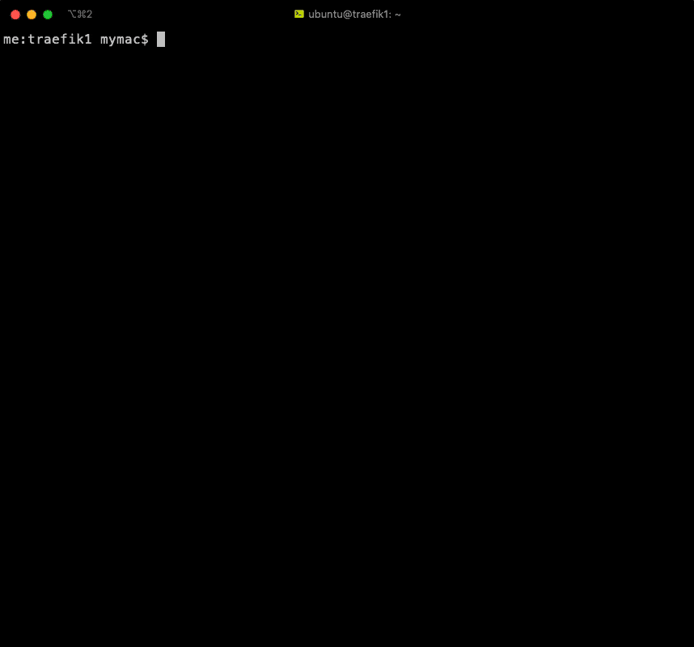
Traefik 1
Version: 1.7.19
Installation
✓ Bundled
✓ Installs
Loadbalancer
✓ 404 Status code
✓ Descriptive error
Ingress
✓ Ingress has ADDRESS
✓ Ingress works
HTTPS
✓ Traffic accepted
✓ Default certificate
✓ Content served
Dashboard
× Not enabled
Metrics
✓ Enabled
✓ Prometheus format
Canary
✓ Enabled
✓ Works
Performance
× Not best
ref: https://rancher.com/docs/k3s/latest/en/advanced/#auto-deploying-manifests

Slide 21

Traefik 2
Version: 2.1.3
Installation
× No official install docs
✓ Installs
Loadbalancer
✓ 404 Status code
✓ Descriptive error
Ingress
✓ Ingress has ADDRESS
✓ Ingress works
HTTPS
✓ Traffic accepted
✓ Default certificate
× No content served
Dashboard
✓ Enabled
✓ Rich details
Metrics
✓ Enabled
✓ Prometheus format
Canary
× Only by CRD
Performance
✓ Least memory usage
ref: https://docs.traefik.io/getting-started/install-traefik/

Slide 22
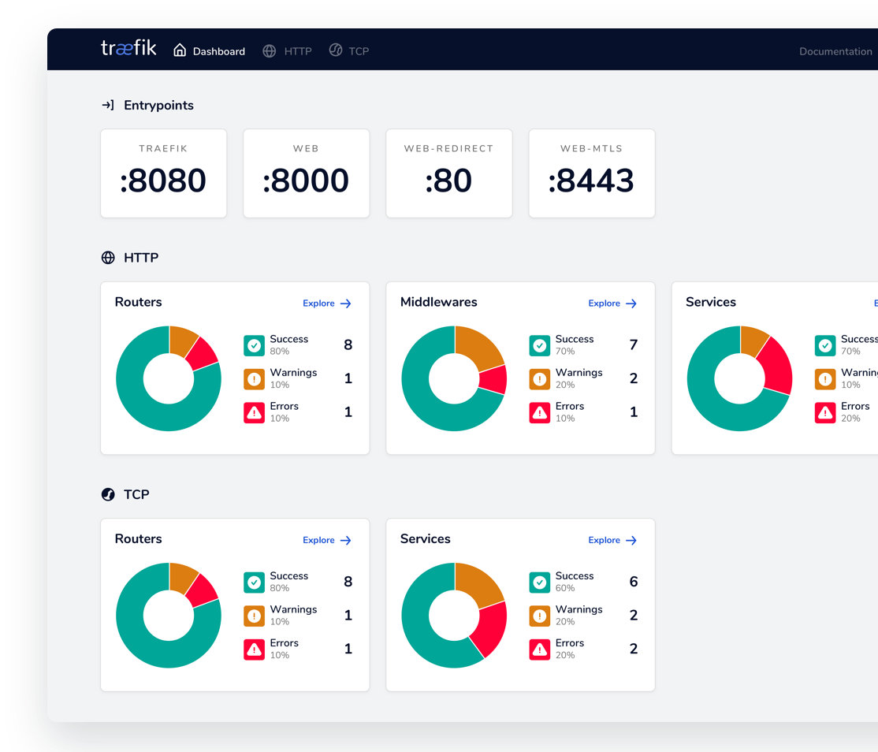
Traefik 2
Dashboard

Slide 23

NGINX
Version: 1.6.1
Installation
✓ Official install docs
× Complicated install
Loadbalancer
✓ 404 Status code
✓ Descriptive error
Ingress
× Ingress has no ADDRESS
✓ Ingress works
HTTPS
✓ Traffic accepted
✓ Default certificate
× No content served
Dashboard
✓ Enabled
× Missing rich details
Metrics
× Not enabled
Canary
✓ Enabled
× Doesn't work
Performance
✓ Least CPU usage
ref: https://docs.nginx.com/nginx-ingress-controller/installation/installation-with-manifests/

Slide 24
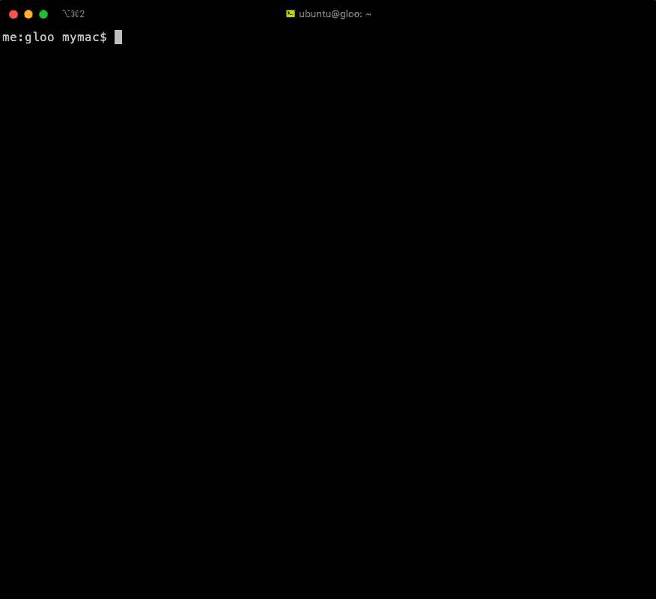
gloo
Version: 1.3.4
Installation
✓ Official install docs
✓ Installs
Loadbalancer
× 404 Status code
× Descriptive error
Ingress
× Ingress has no ADDRESS
✓ Ingress works
HTTPS
× Traffic accepted
× Default certificate
× Content served
Dashboard
× Not enabled
Metrics
✓ Enabled
✓ Prometheus format
Canary
× Not available (use Flagger)
Performance
✓ Lowest latency
✓ Most requests/sec
ref: https://docs.solo.io/gloo/latest/gloo_integrations/ingress

Slide 25

HAProxy
Version: 1.3.4
Installation
✓ Official install docs
✓ Installs
Loadbalancer
× Not exposed
✓ 404 Status code
✓ Descriptive error
Ingress
× Ingress has no ADDRESS
✓ Ingress works
HTTPS
× Traffic accepted
× Default certificate
× Content served
Dashboard
✓ Enabled
✓ Rich details
Metrics
✓ Enabled
✓ Prometheus format
Canary
× Not available
Performance
× Not best
ref: https://github.com/haproxytech/kubernetes-ingress

Slide 26
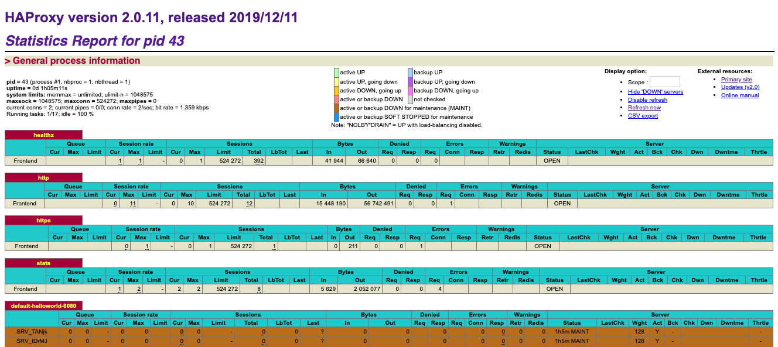
HAProxy
Dashboard

Slide 27
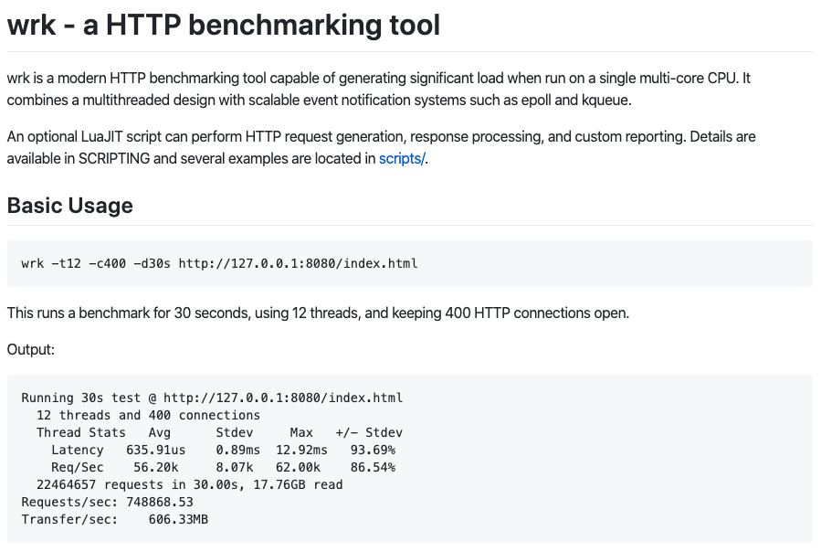
Performance Method
Tools

Slide 28
Performance Results
traefik1
me:traefik1 mymac$ docker run --rm williamyeh/wrk -d 60s -H 'Host: helloworld' http://$IP && echo && kubectl top pod -A
Running 2m test @ http://192.168.64.26
2 threads and 10 connections
Thread Stats Avg Stdev Max +/- Stdev
Latency 5.24ms 2.25ms 32.29ms 77.65%
Req/Sec 0.97k 113.40 1.27k 70.48%
232696 requests in 2.00m, 45.71MB read
Requests/sec: 1938.19
Transfer/sec: 389.91KB
NAMESPACE NAME CPU(cores) MEMORY(bytes)
default helloworld-c569b9946-2rlp8 113m 6Mi
default helloworld-c569b9946-chxvq 111m 9Mi
kube-system coredns-d798c9dd-z6h8b 2m 8Mi
kube-system local-path-provisioner-58fb86bdfd-qjnjp 2m 9Mi
kube-system metrics-server-6d684c7b5-jwt7p 1m 10Mi
kube-system svclb-traefik-gvpcl 0m 1Mi
kube-system traefik-6787cddb4b-vg98n 557m 24Mi
me:traefik1 mymac$

Slide 29
Performance Results
traefik2
me:traefik2 mymac$ docker run --rm williamyeh/wrk -d 60s -H 'Host: helloworld' http://$IP && echo && kubectl top pod -A
Running 2m test @ http://192.168.64.24
2 threads and 10 connections
Thread Stats Avg Stdev Max +/- Stdev
Latency 6.71ms 2.82ms 39.06ms 74.09%
Req/Sec 756.83 78.33 0.94k 73.02%
180844 requests in 2.00m, 31.56MB read
Requests/sec: 1506.52
Transfer/sec: 269.23KB
NAMESPACE NAME CPU(cores) MEMORY(bytes)
default helloworld-c569b9946-gnvv2 91m 5Mi
default helloworld-c569b9946-s9j72 90m 5Mi
kube-system coredns-d798c9dd-6bbxp 2m 15Mi
kube-system local-path-provisioner-58fb86bdfd-nxhkc 1m 8Mi
kube-system metrics-server-6d684c7b5-mn6kx 1m 13Mi
traefik svclb-traefik-ingress-6v6rn 0m 1Mi
traefik traefik-774fbb9f48-sfk4x 502m 9Mi
me:traefik2 mymac$

Slide 30
Performance Results
nginx
me:nginx mymac$ docker run --rm williamyeh/wrk -d 60s -H 'Host: helloworld' http://$IP && echo && kubectl top pod -A
Running 2m test @ http://192.168.64.25
2 threads and 10 connections
Thread Stats Avg Stdev Max +/- Stdev
Latency 6.37ms 1.78ms 31.14ms 79.46%
Req/Sec 790.25 84.44 0.98k 75.10%
188834 requests in 2.00m, 41.23MB read
Requests/sec: 1573.00
Transfer/sec: 351.70KB
NAMESPACE NAME CPU(cores) MEMORY(bytes)
default helloworld-c569b9946-4g489 144m 5Mi
default helloworld-c569b9946-xnvsz 145m 5Mi
kube-system coredns-d798c9dd-lzmgd 2m 8Mi
kube-system local-path-provisioner-58fb86bdfd-dh6b4 2m 7Mi
kube-system metrics-server-6d684c7b5-k7bg7 1m 13Mi
nginx-ingress nginx-ingress-f599ddd8-rg2cg 285m 12Mi
nginx-ingress svclb-nginx-ingress-j2dbh 0m 2Mi
me:nginx mymac$

Slide 31
Performance Results
gloo
me:gloo mymac$ docker run --rm williamyeh/wrk -d 60s -H 'Host: helloworld' http://$IP && echo && kubectl top pod -A
Running 2m test @ http://192.168.64.23
2 threads and 10 connections
Thread Stats Avg Stdev Max +/- Stdev
Latency 4.02ms 1.67ms 52.10ms 78.84%
Req/Sec 1.26k 135.13 1.58k 74.02%
301661 requests in 2.00m, 66.74MB read
Requests/sec: 2512.61
Transfer/sec: 569.27KB
NAMESPACE NAME CPU(cores) MEMORY(bytes)
default helloworld-c569b9946-8dczb 158m 6Mi
default helloworld-c569b9946-sv9fg 157m 5Mi
gloo-system discovery-5f97667c4c-q4b2z 4m 27Mi
gloo-system gloo-d7c867cf4-dlr4q 4m 29Mi
gloo-system ingress-fb4bcff75-gc9wn 2m 22Mi
gloo-system ingress-proxy-69568c6649-4zzcj 387m 16Mi
gloo-system svclb-ingress-proxy-4l2bt 0m 1Mi
kube-system coredns-d798c9dd-kcddw 2m 11Mi
kube-system local-path-provisioner-58fb86bdfd-4hr2d 2m 7Mi
kube-system metrics-server-6d684c7b5-9w942 1m 14Mi
me:gloo mymac$

Slide 32
Performance Results
haproxy
me:haproxy mymac$ docker run --rm williamyeh/wrk -d 60s -H 'Host: helloworld' http://$IP && echo && kubectl top pod -A
Running 2m test @ http://192.168.64.27
2 threads and 10 connections
Thread Stats Avg Stdev Max +/- Stdev
Latency 4.83ms 4.74ms 86.42ms 86.79%
Req/Sec 1.24k 172.68 1.70k 68.75%
297071 requests in 2.00m, 51.85MB read
Requests/sec: 2474.04
Transfer/sec: 442.14KB
NAMESPACE NAME CPU(cores) MEMORY(bytes)
default helloworld-c569b9946-4qjnw 152m 5Mi
default helloworld-c569b9946-c8wsl 152m 5Mi
haproxy-controller haproxy-ingress-596fb4b4f4-pwfg9 376m 81Mi
haproxy-controller ingress-default-backend-558fbc9b46-w9spl 1m 1Mi
haproxy-controller svclb-haproxy-ingress-t22ss 0m 2Mi
kube-system coredns-d798c9dd-jvdvh 2m 9Mi
kube-system local-path-provisioner-58fb86bdfd-lwl8c 2m 8Mi
kube-system metrics-server-6d684c7b5-xlmqd 1m 14Mi
me:haproxy mymac$

Slide 33
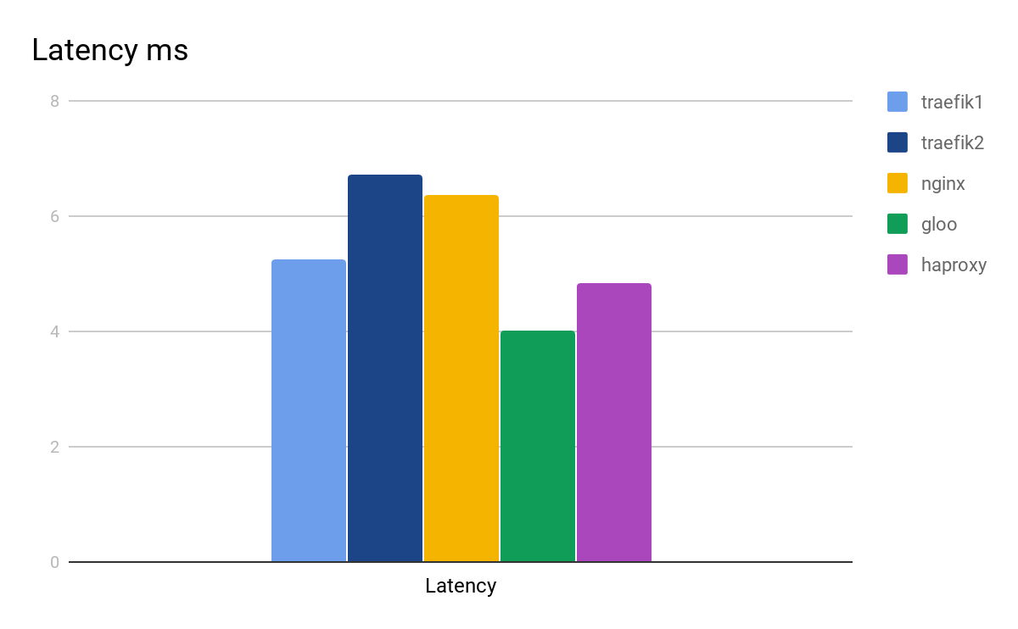
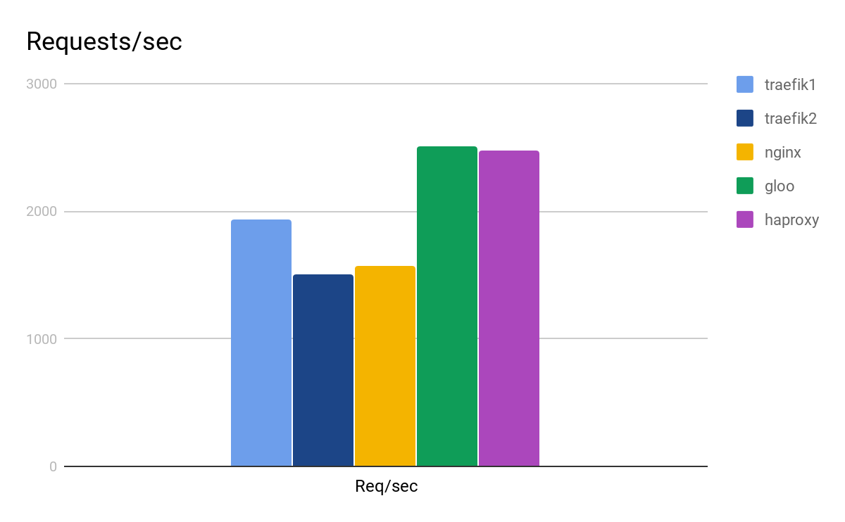
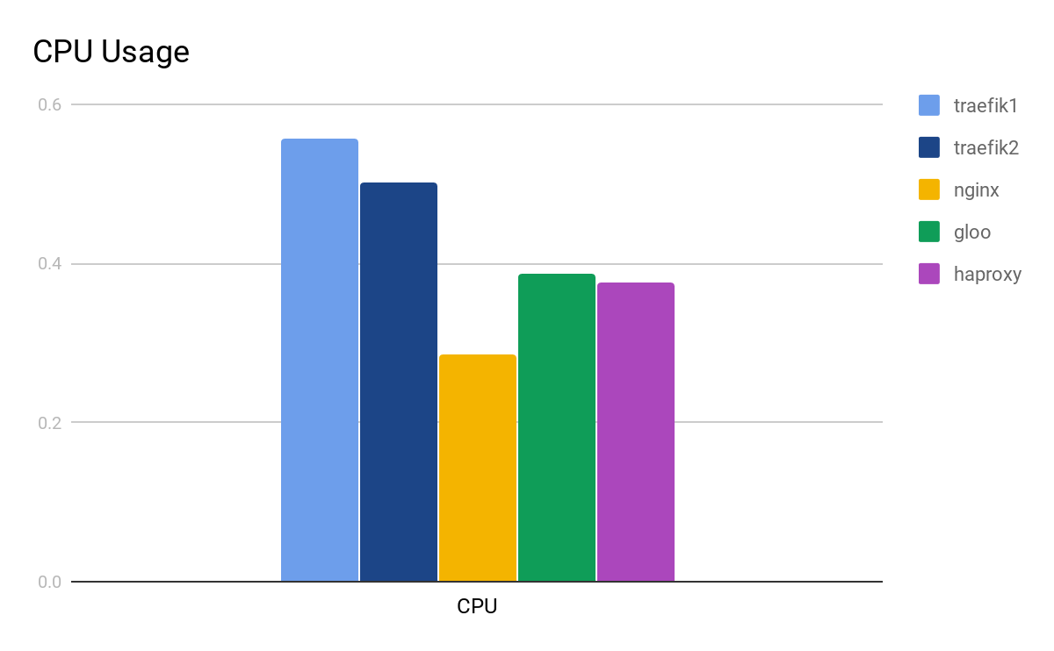
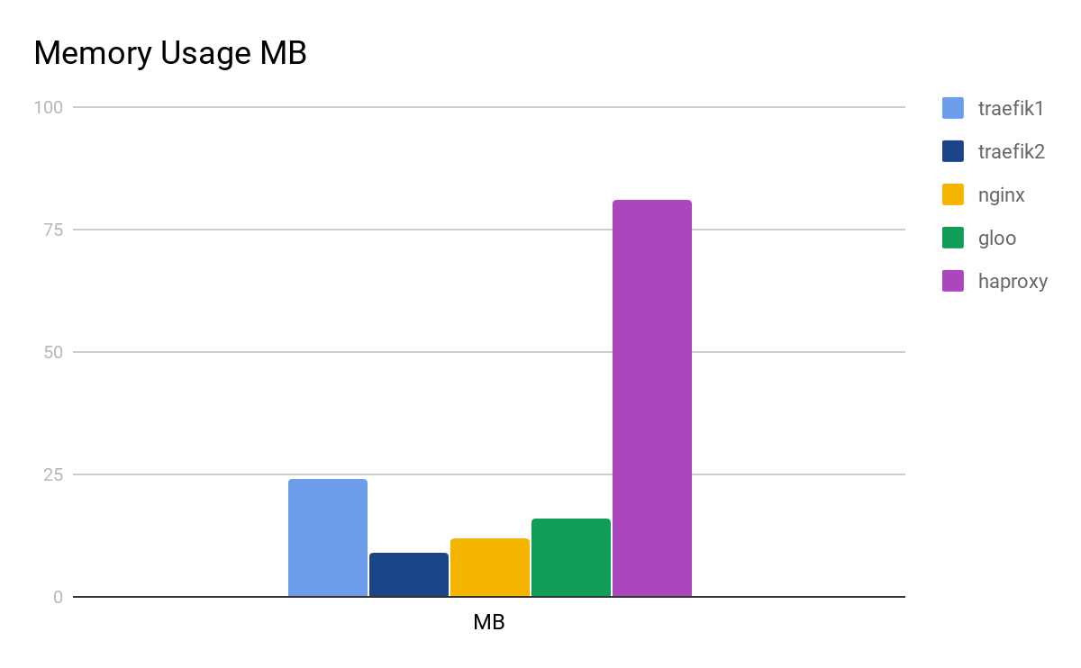
Performance Results
Comparison
lower is better
higher is better
lower is better
lower is better

Slide 34

Summary
Choose architecture
Design end-to-end encryption
Consider which features matters most to you?
Evaluate technologies
Workaround short-comings
Confirm adequate performance
Deploy and Enjoy!
(Test scripts available on Meetup Github)

Slide 35
The End

